Slide 1
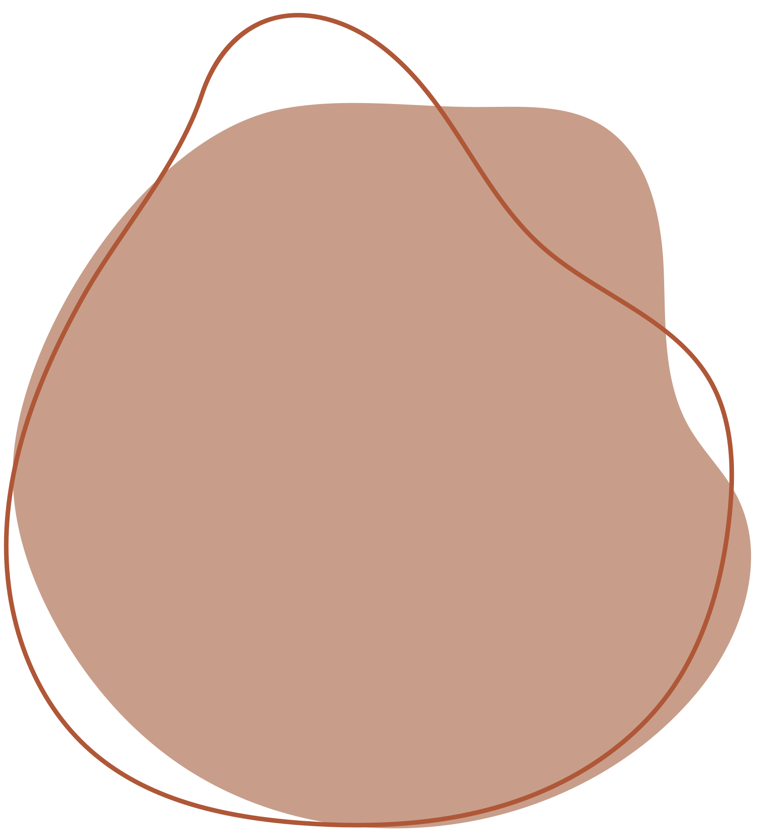

VISUAL
QUESTION
ANSWERING

Slide 2
PRESENTERS:
Guide:
Arpita
Gupta
2010030362_M.RUSHITHA SRI
2010030436_K.DIMPLE
2010030438_K.SIRISHA
2010030550_K.KAVYA

Slide 3

TABLE OF CONTENT:
• Introduction
• Problem Statement
• Motivation
• Objectives
• Literature Survey
• Dataset
• Techniques
• Conclusion
• References
• Thank you

Slide 4
Introduction
Visual Question Answering (VQA) is the task of answering questions about a given piece of visual content such as an image. Answering questions about visual content requires a variety of skills which include recognizing entities and objects, reasoning about their interactions with each other, both spatially and temporally, reading text, interpreting abstract and graphical illustrations as well as using external knowledge not directly present in the given content.

Slide 5
PROBLEM STATEMENT:
Building an AI system that can answer natural language queries about a given image and broader idea of VQA is to understand the contents of an image similar to how humans do, and communicate effectively about that image in natural language.

Slide 6
MOTIVATION:
VQA is interesting because it requires combining visual and language understanding. A model that solves this task demonstrates a more general understanding of images, it must be able to answer completely different questions about an image, oftentimes even addressing different sections of the image.

Slide 7

OBJECTIVES:
The objective of VQA is to extract question-relevant semantic information from the images, which ranges from the detection of minute details to the inference of abstract scene.

Slide 8
Literature Survey
S.No: | Authors | Title | Publishing | Techniques& Dataset | Pros | Cons
1. | 1.Sayedshayan Hashemi Hossein Abad 2.Mehran Safayani1 · 3.Abdolreza Mirzaei1 | Multiple answers to a question: a new approach for visual question answering | Department of Electrical and Computer Engineering, Isfahan University of Technology, Isfahan 84156-83111, Iran(published online:01 January 2020) | Glimpse training approach evaluation “Icon Question Answering (ICQA)” to train and evaluate our new sliding window approach. Multi-class classification approach evaluation | It can be observed that the glimpse training approach learns from fewer data, generalizes more accurately, and demands less computational power compared to the multi-class classification approach | The questions that ask about the location or count cannot be answered because the glimpse training approach answers questions regarding a local part of an image and these types of questions require a global view of the image.

Slide 9
S.No: | Authors | Title | Publishing | Techniques& Dataset | Pros | Cons
2. | Yuling Xi a , Yanning Zhang a , Songtao Ding b , Shaohua Wan | Visual question answering model based on visual relationship detection | School of Computer Science, Northwestern Polytechnical University, Xi’an 710072, China (2020) | Target detection model Quantitative analysis | The question-based attention mechanism can help the model focus on target areas most relevant to the question. | Detecting the target in the current scene and abstracting the semantic information can help understand the content of the scene, but it is not comprehensive enough to capture all the elements needed for the answer generation.
3. | Sanket Shah,Anand Mishra, Naganand Yadati,Partha Pratim Talukdar | KVQA: Knowledge-Aware Visual Question Answering | IIIT Hyderabad, India and Indian Institute of Science, Bangalore, India (2019) | KVQA | Once visual entities are linked to Wikidata, the task of Visual Question Answering becomes equivalent to fetching relevant facts from KG, reasoning over them, and learning to answer questions | question answering technique such as memory networks does not scale well with large number of world knowledge facts associated with multiple entities.

Slide 10
S.No: | Authors | Title | Publishing | Techniques& Dataset | Pros | Cons
4. | Daniel Gordon , Aniruddha Kembhavi, Mohammad Rastegari, Joseph Redmon, Dieter Fox , Ali Farhadi | IQA: Visual Question Answering in Interactive Environments | Paul G. Allen School of Computer Science, Allen Institute for Artificial Intelligence (2018) | Visual Navigation, Visual Learning by Simulation Interactive Question Answering Dataset (IQUAD) | The Hierarchical Interactive Memory Network, consisting of a factorized set of controllers, allowing the system to learn from long trajectories. | Due to the 2D nature of the semantic spatial map, this algotithm is unable to differentiate between an object being inside a container and being on top of the container.
5. | Remi Cadene, Hedi Ben-younes, Matthieu Cord, Nicolas Thome | MUREL: Multimodal Relational Reasoning for Visual Question Answering | Sorbonne University, Paris. Heuritech, 248 rue du Faubourg Saint-Antoine, 75012 Paris. Conservatoire National des Arts et Metiers, 75003 Paris (2019) | TDIUC (Task Directed Image Understanding Challenge) | This system is based on rich representations of visual image regions that are progressively merged with the question representation. | Iterations through the MuRel cell tend to gradually discard regions, keeping only the most relevant ones.

Slide 11
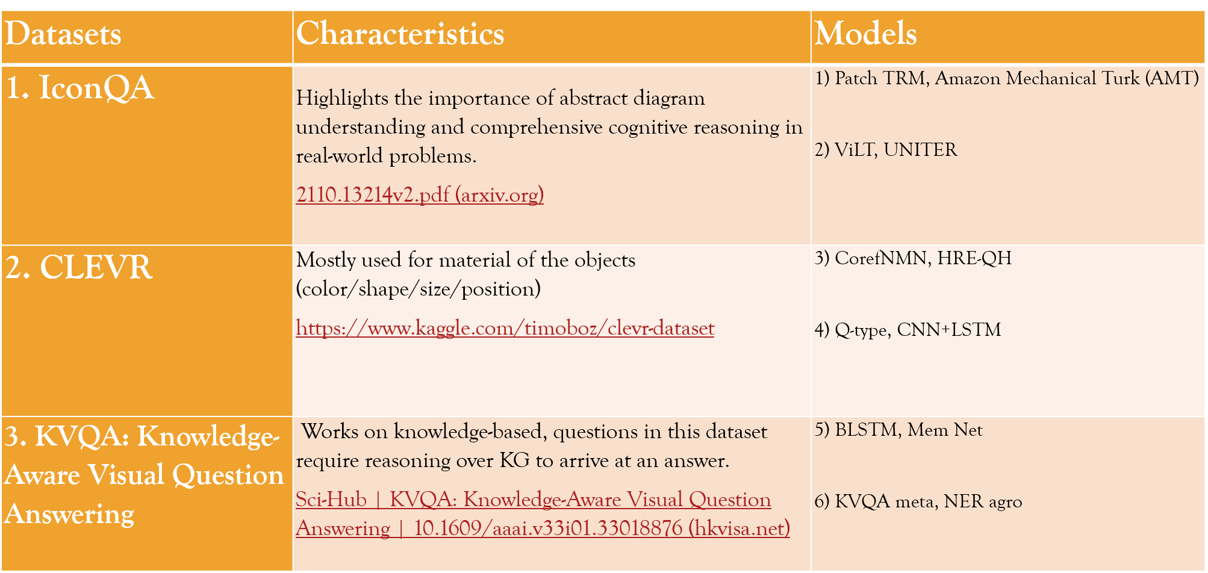
DATASETS:

Slide 12
TECHNIQUES:
1) Patch TRM :
This model applies a pyramid cross-modal Transformer with input diagram embeddings pre-trained on the icon dataset.
2) AMAZON MECHANICAL TURK (AMT):
In this model we post the test set of IconQA on Amazon Mechanical Turk (AMT) and ask people to provide answers to the questions in the test set.
We also ask the participants to provide us with their age group anonymously. We strongly encourage
parents who have young children to let their children complete the questionnaires, as their answers give us insights to how the designed audience of these questions perform.

Slide 13
3) COREFNMN:
It is a best performing model which identifies a reference phrase in the current question and proceeds to visually ground the corresponding referent in the image.

Slide 14
CONCLUSION:
Combines a range of vision problems in one, such as : Scene Recognition , Object Recognition , Object Localization.

Slide 15
REFERENCES:
Hashemi Hosseinabad, Sayedshayan, Mehran Safayani, and Abdolreza Mirzaei. "Multiple answers to a question: a new approach for visual question answering." The Visual Computer 37, no. 1 (2021): 119-131.
Xi, Yuling, Yanning Zhang, Songtao Ding, and Shaohua Wan. "Visual question answering model based on visual relationship detection." Signal Processing: Image Communication 80 (2020): 115648.
Shah, Sanket, Anand Mishra, Naganand Yadati, and Partha Pratim Talukdar. "Kvqa: Knowledge-aware visual question answering." In Proceedings of the AAAI Conference on Artificial Intelligence, vol. 33, no. 01, pp. 8876-8884. 2019.
Gordon, Daniel, Aniruddha Kembhavi, Mohammad Rastegari, Joseph Redmon, Dieter Fox, and Ali Farhadi. "Iqa: Visual question answering in interactive environments." In Proceedings of the IEEE conference on computer vision and pattern recognition, pp. 4089-4098. 2018.
Cadene, Remi, Hedi Ben-Younes, Matthieu Cord, and Nicolas Thome. "Murel: Multimodal relational reasoning for visual question answering." In Proceedings of the IEEE/CVF conference on computer vision and pattern recognition, pp. 1989-1998. 2019.

Slide 16
THANK YOU

